Slide 1
PaaT
Pet as a Thing

Slide 2
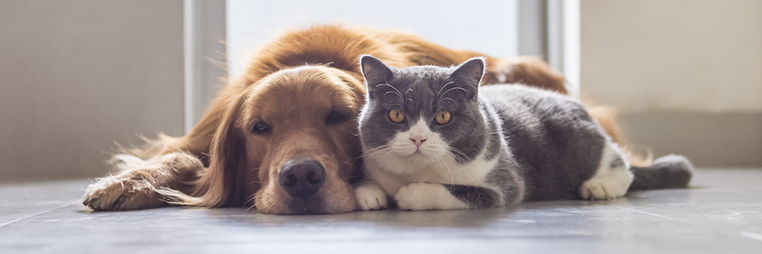
SCENARIO
There are many health benefits of owning a pet. They can increase opportunities to exercise, get outside, and socialize.
Pets can help manage loneliness and depression by giving us companionship.
Giving these considerations, losing a pet is, for the owner, the worst thing that could ever happen to him.

Slide 3
SOME STUDIES (2009)
The problem over lost pets is broadly recognized, but ‘actual’ statistics are hard to come by as no national reporting structure exists.
over 135 millions of dogs and cats in the United State
According to the American Humane Association 1 out of 3 pets become lost at some point in their lifetime and close to 10 million dogs and cats are lost or stolen in the US every single year. According to the Coalition for Reuniting Pets and Families, less than 23% of lost pets in the United States are reunited with their owners.
1/3 of ALL dogs and cats in the USA go MISSING
more than 80% of missing pets are NEVER FOUND

Slide 4

SOME STUDIES (2016)
Peeva conducted a survey sporadically over the course of several months in 2016 to get a more accurate gauge of the approximate percentage of owned dogs and cats in the United States that are reported lost, and of these reported lost pets (specifically dogs and cats), the percentage that are reclaimed by their owners (those that reported the pets as lost) by surveying a sample set indicative of the US pet owning population as a whole. The results and conclusions were surprising: the previous statistics reported are actually the same as their findings.

Slide 5
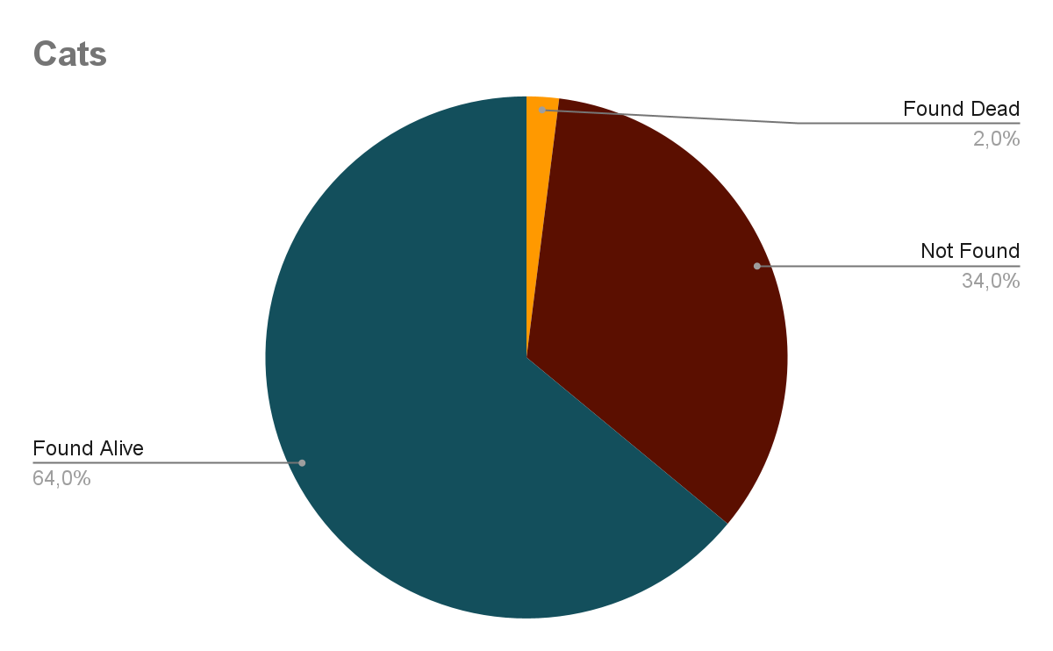
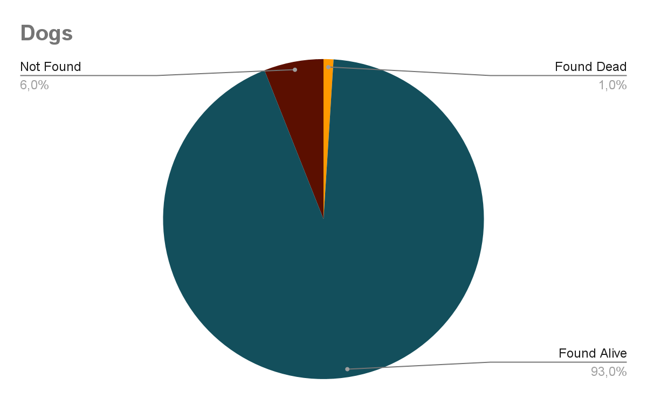
MISSING PETS’ RECOVERY STATS (2022, PurringPal)

Slide 6
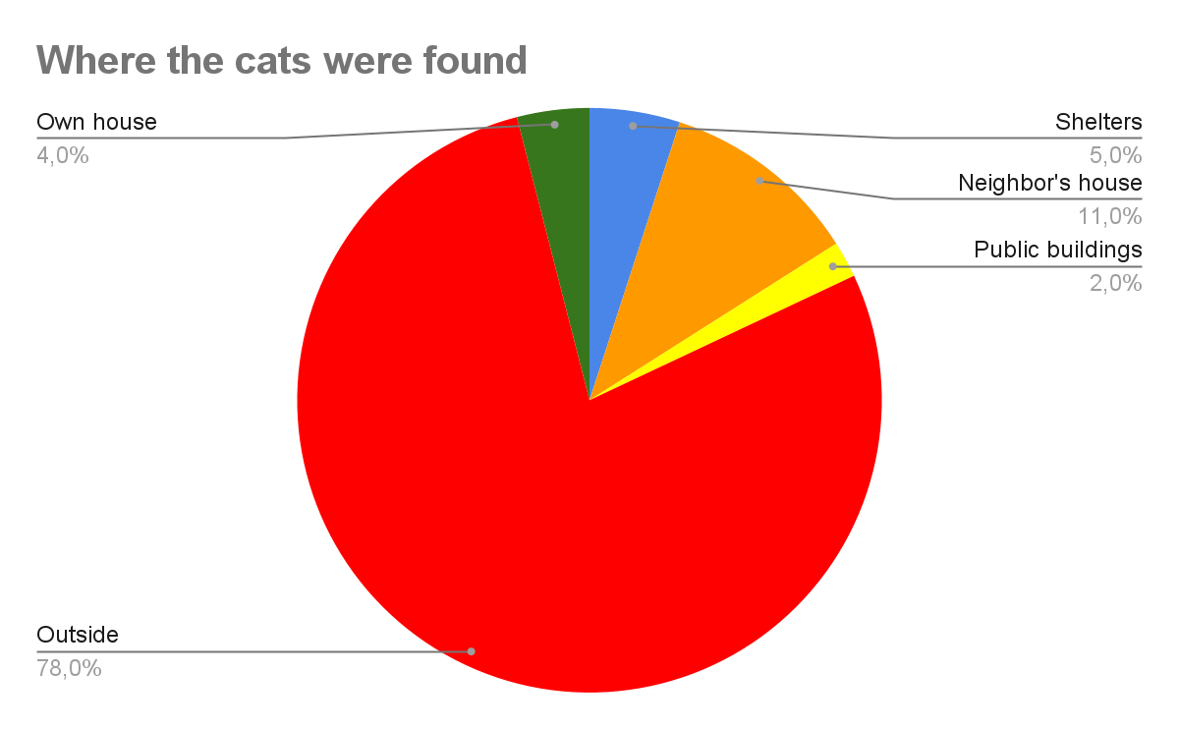
LOST CATS ANALYSIS

Slide 7
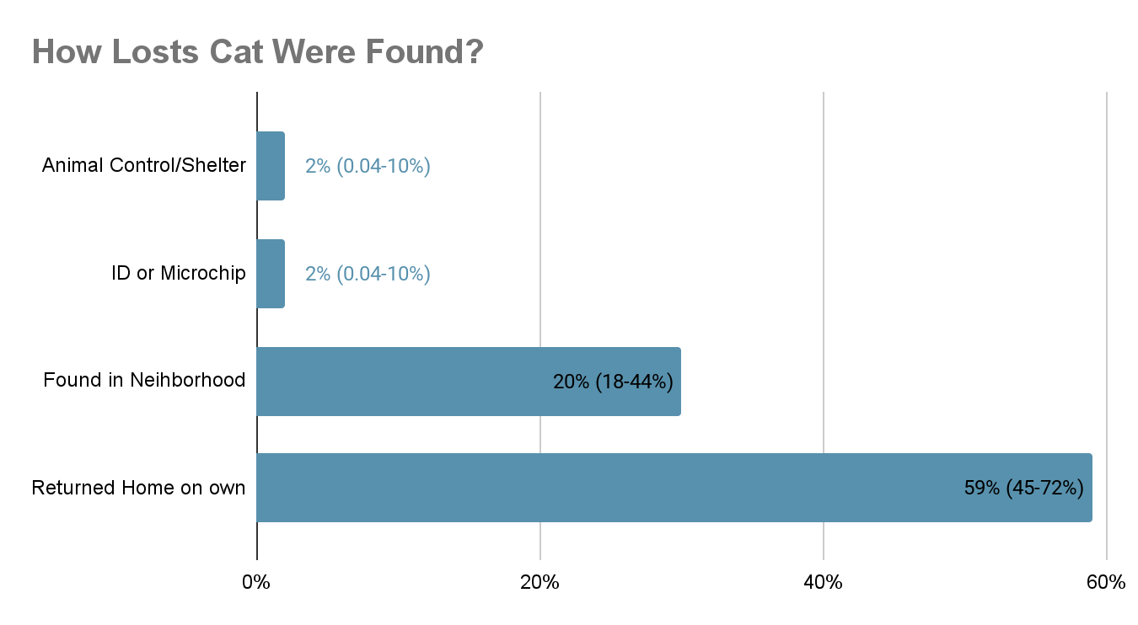
LOST CATS ANALYSIS

Slide 8
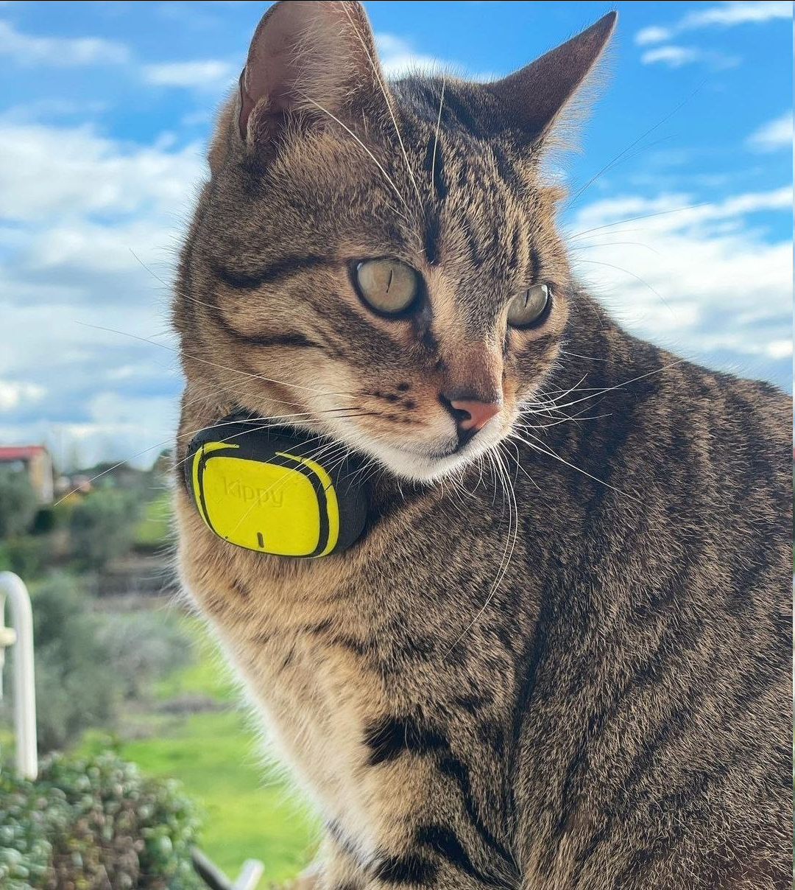
COMPETITOR ANALYSIS (KIPPY)
Kippy is an italian company that produces a pet tracker for dogs and cats which relies on GSM for radio communication and on GPS, WiFi, GSM and Bluetooth for localization. The initial cost of the device is around €50.
Although it is one of the most complete solutions on the market, there are many issues and lacks which should be improved:
The module cannot be disassembled, so issues related to battery, radio or GPS malfunction cannot be fixed easily and the whole device must be replaced
The recognized location is not accurate when there is no affordable satellite signal (and no information about this is given to the user)
There are no actuators that let the user find the pet in though scenarios, as in the night or in hidden places (bushes, walls, enclosed areas…)
Sensors that allow user to know if his pet is steady for too long are missing (pet could have lost tracker or have health issues)
An history of last day positions is missing
GSM subscription is costly due to licencing (€60/year)

Slide 9
WHY IoT?
- Improved Recovery Rates: in case a pet gets lost, the tracking capability and low power consumption of significantly increases the chances of finding and recovering them.
- Continuous Monitoring: owners can access to information about their pet's movements and behavior patterns over time.
- Remote Access: owners can remotely access their pet's location information through mobile applications or web interfaces.
- Integration with Other Devices: For example, it can be sync with smart home systems, allowing automated alerts to be sent to multiple devices or triggering actions like opening a pet door when the pet approaches.
- Data Analytics: generate a wealth of data regarding a pet's activities, location history, and health metrics. This data can be analyzed to gain insights into the pet's behavior, exercise patterns, sleep quality, and more.

Slide 10
USER REQUIREMENTS (1)
Works for
At least 24 hours: in case we lose our pet it is important that the device remains active for at least one day, that could be a sufficient amount of time to track and retrieve it;
At least one/two weeks: in case we do not lose contact with our pet, it is sufficient that the device remains active for at least one/two weeks. This period of time can be used by the user if he will stay out for days, and it’s also a good compromise between time required to retrieve the pet and efficiency consumption from a user point of view.
Sampling time and promptly:
5 min: when we lose the contact with the pet, 5 minutes could be a sufficient amount of time to update the position, because in 5 minutes the pet could not do so much road, and the user can rescue it;
60 min: if the pet is inside, receiving frequent notifications or updates can be overwhelming; then, it provides a good balance between accuracy and precision. Moreover, the system can reduce the frequency of GPS updates, thereby conserving battery life and allowing the device to operate for longer periods without recharging.

Slide 11
USER REQUIREMENTS (2)
Accuracy:
10-15m, that is a sufficient range in order to be able for the user to find his pet.
False positive and false negative has to be detectable.
Security:
data exchanged by the application must be encrypted in order to hide sensitive information (like the position of the pet) to malicious attackers, providing confidentiality.
Events:
{"latitude": float, "longitude": float, “sat_num”: int}: since data transfer size are in the order of 2^7 bytes (+ headers) and since we need that the system has to be energy efficient, and since we need a communication in the order of ≈10 km, LoRa is strongly suitable for our system

Slide 12
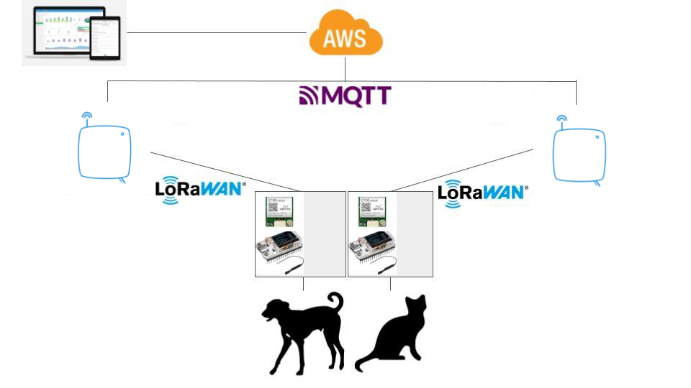
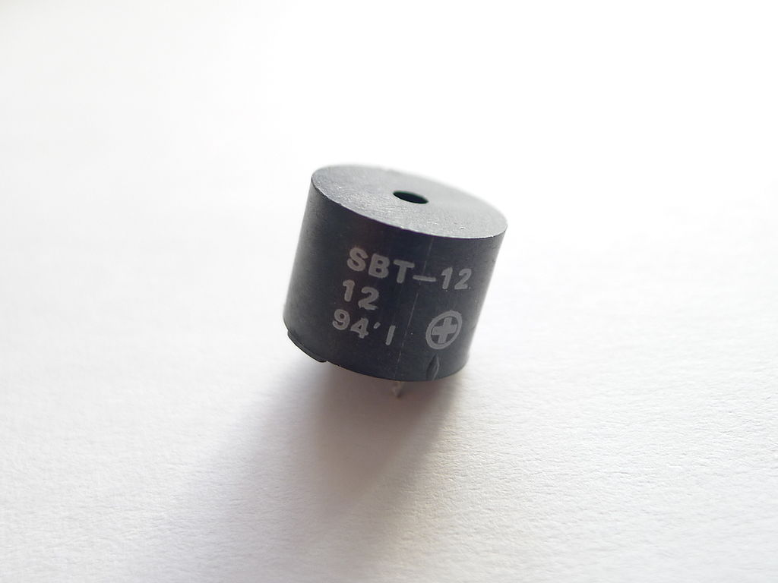
OUR SOLUTION: PAAT

Slide 13





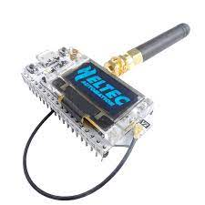







OVERVIEW
AWS Amplify
HTML, CSS, JavaScript, etc.
TTN Client
AWS Lambda
Amazon API Gateway
Aws IoT Core
Dynamic API calls over HTTPS
Amazon DynamoDB

Slide 14
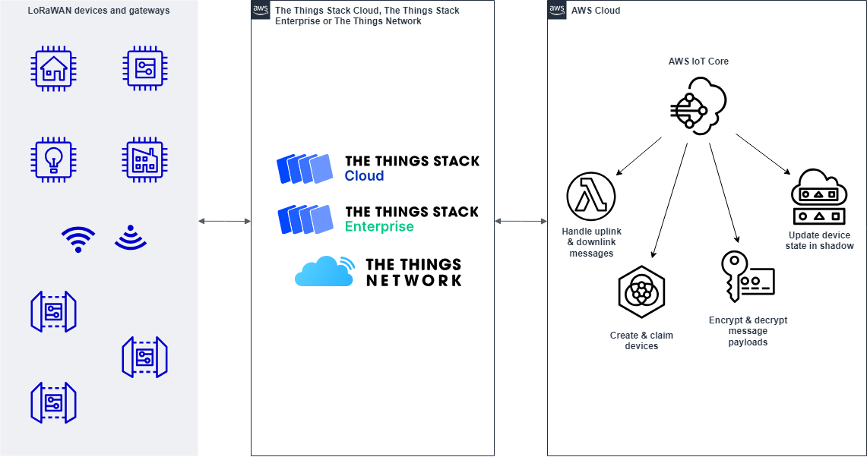
TTN AND AWS

Slide 15



OVERVIEW (REAL WORLD)
IoT
Edge
AWS Amplify
HTML, CSS, JavaScript, etc.
AWS Lambda
INTERNET
Amazon API Gateway
Aws IoT Core
Dynamic API calls over HTTPS
Amazon DynamoDB

Slide 16
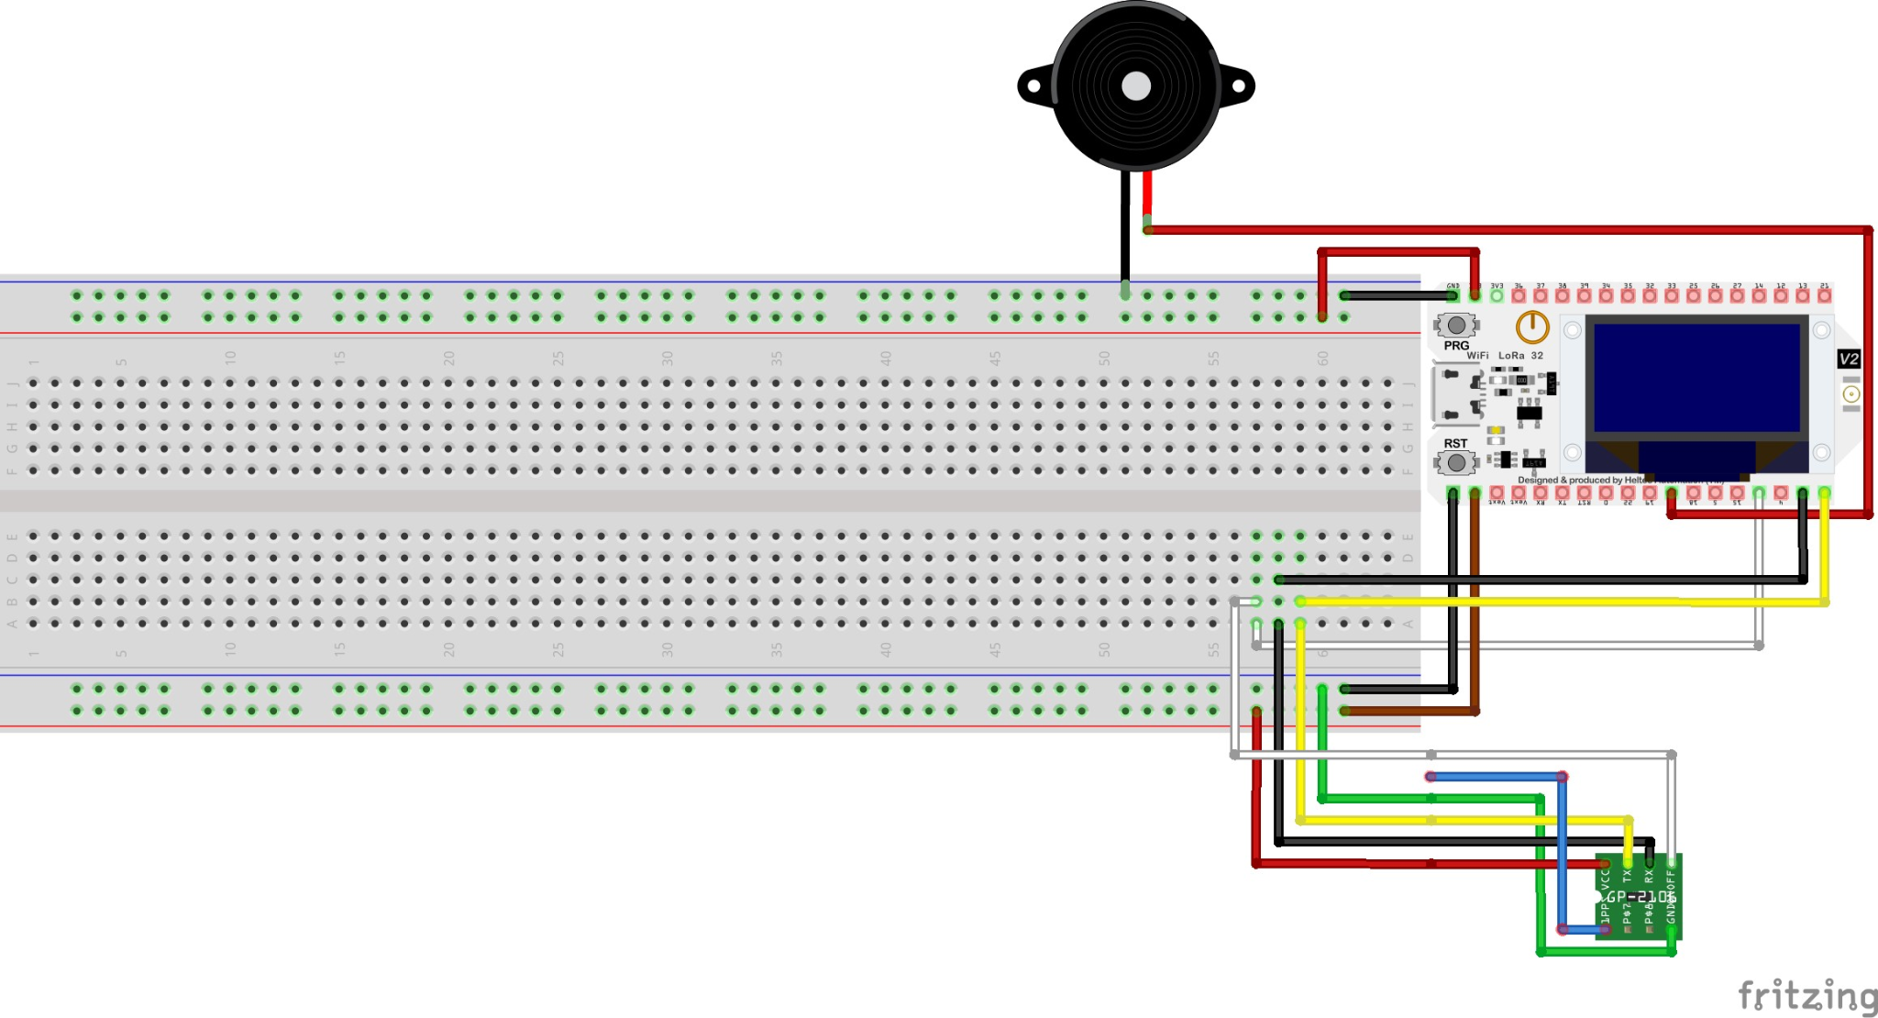
SENSORS AND ACTUATORS

Slide 17
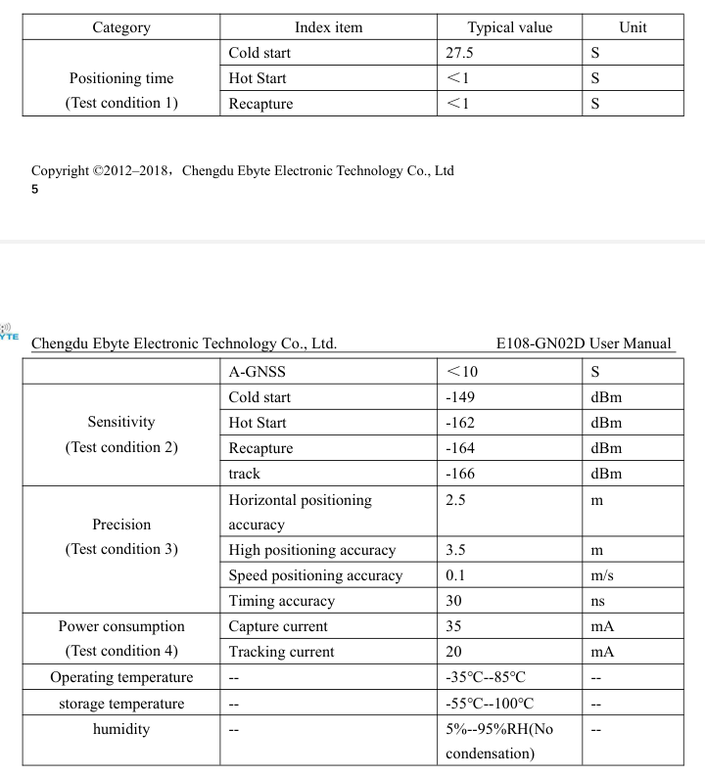
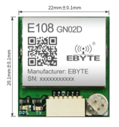
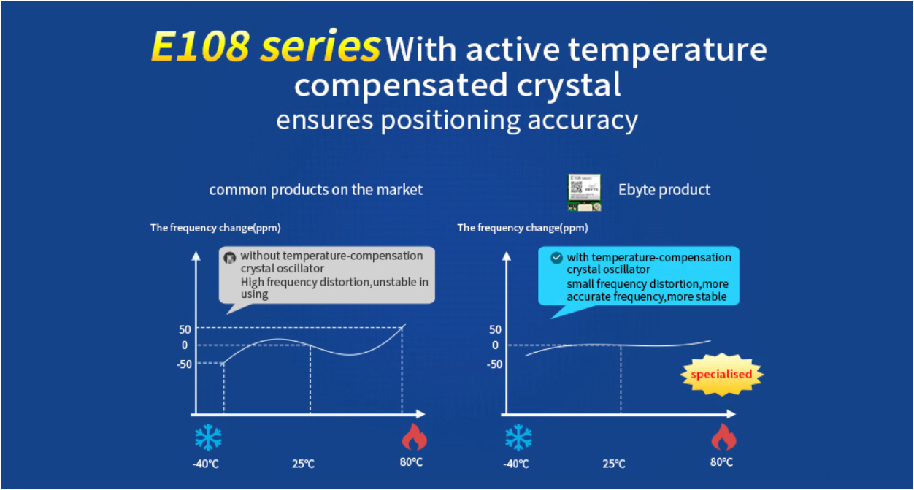
GPS MODULE (E108-GN02)

Slide 18

WHY LORA?
Covered distance;
Low power consumption;
Free;
Low bandwidth

Slide 19
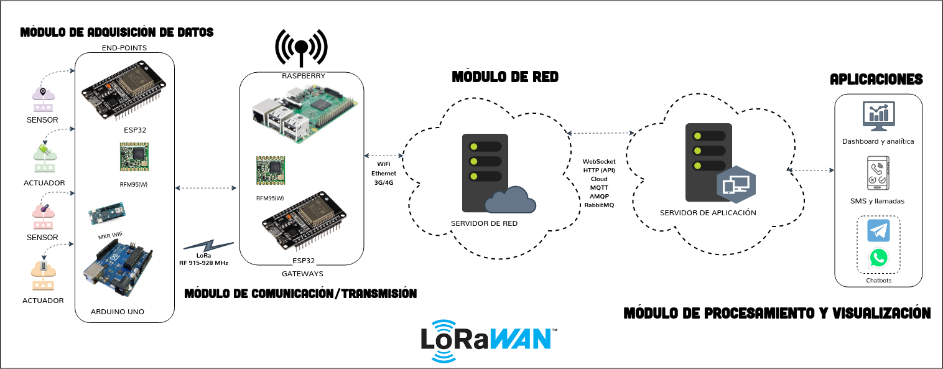
LORA DEVICE
Lora has 2 device classes:
Class A device
Can only receive after a send
Smallest power consumption
Can be used on battery
2) Class C device
Always listening: low latency
More power consumption
Cannot be used on battery

Slide 20
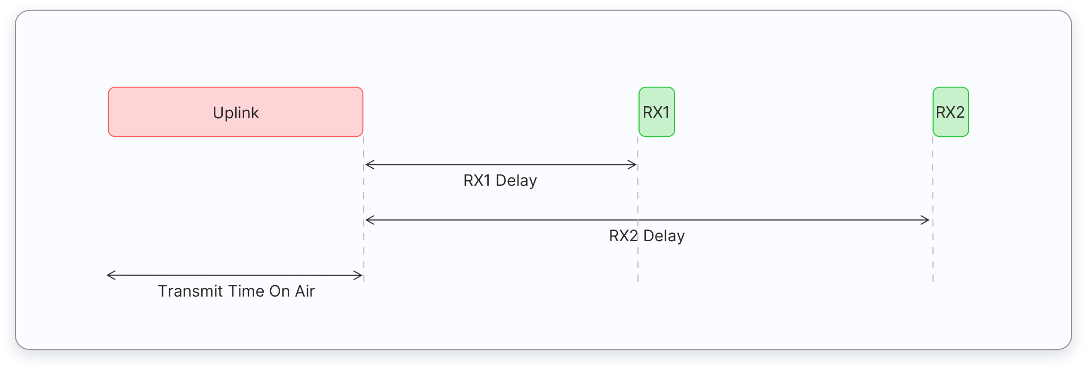
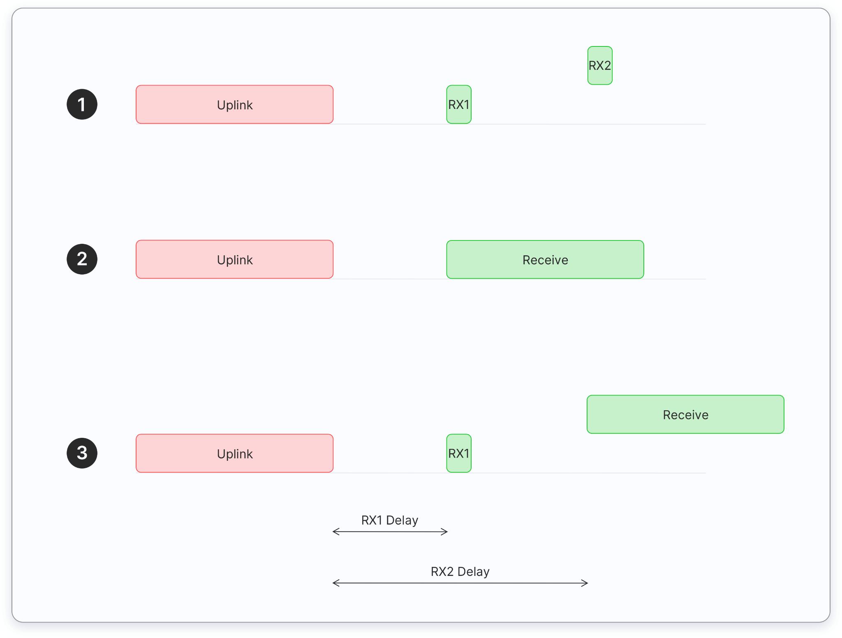
LORA: CLASS A DEVICE
All LoRaWAN end-devices must support Class A implementation. Class A communication is always initiated by the end-device. A device can send an uplink message at any time. Once the uplink transmission is completed the device opens two short receive (downlink) windows. There is a delay between the end of the uplink transmission and the start of the receive windows (RX1 and RX2 respectively). If the network server does not respond during these two receive windows, the next downlink will be after the next uplink transmission.
Receive without sending first an uplink are blocking.

Slide 21
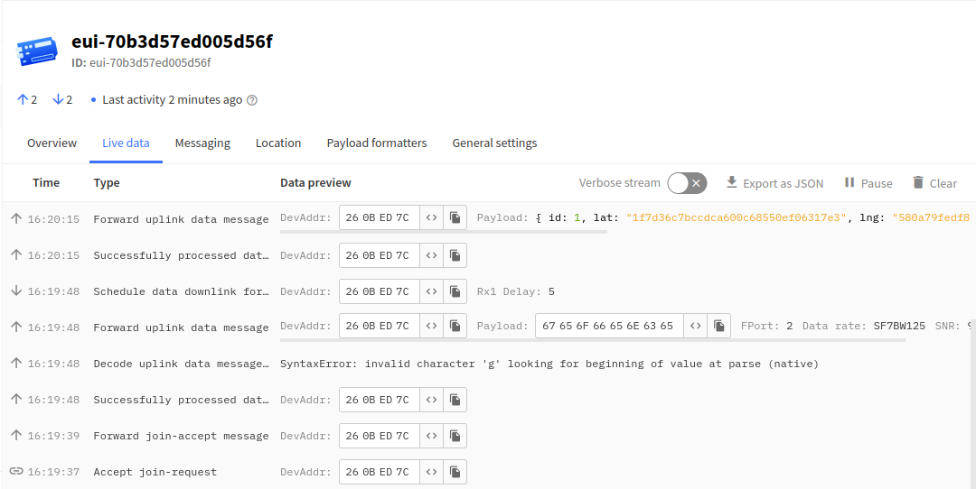
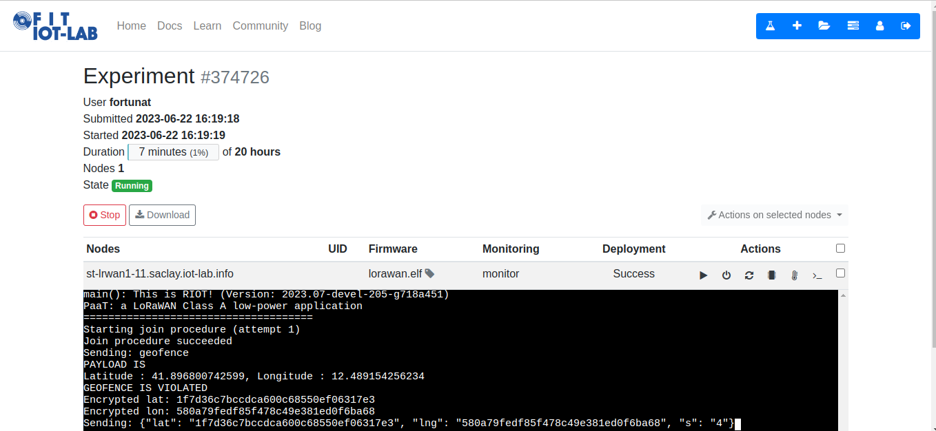
SIMULATIONS ON IOT-LAB W/TTN
For the experiments we setted the script in order to play in that way:
messages sent every 5 minutes;
It send the first 3 position in order that the pet turns out to be in the geofence;
after that first 3 it sends other position in order that the pet turns out to be out the geofence and sends now the alert;

Slide 22
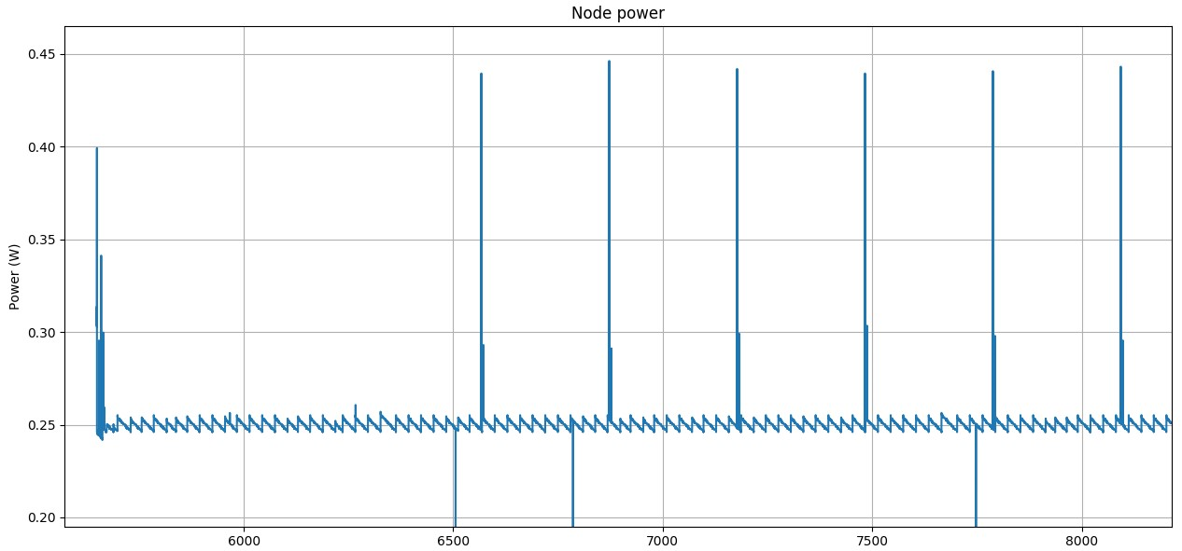
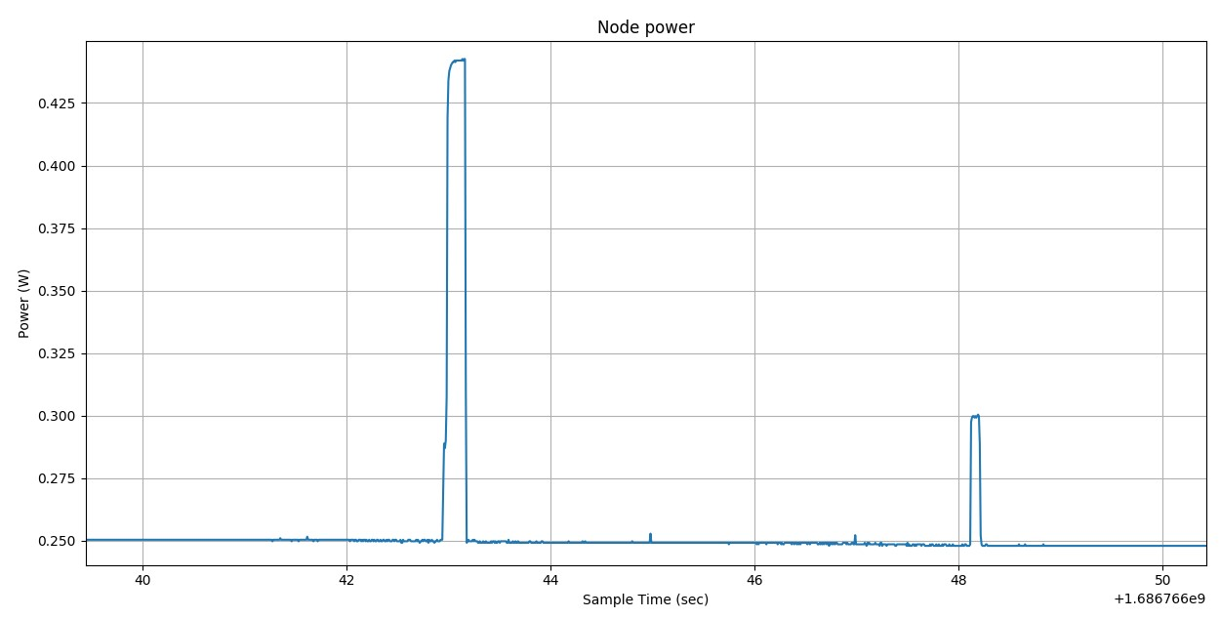
LORA ENERGY CONSUMPTION GRAPH
As we could expect the consumption resonates when the device sends the messages.
Clearly we have 2 peaks for every message, the first one refers to the sending procedure, on the other hand the second one refers the energy needed to receive the message.

Slide 23
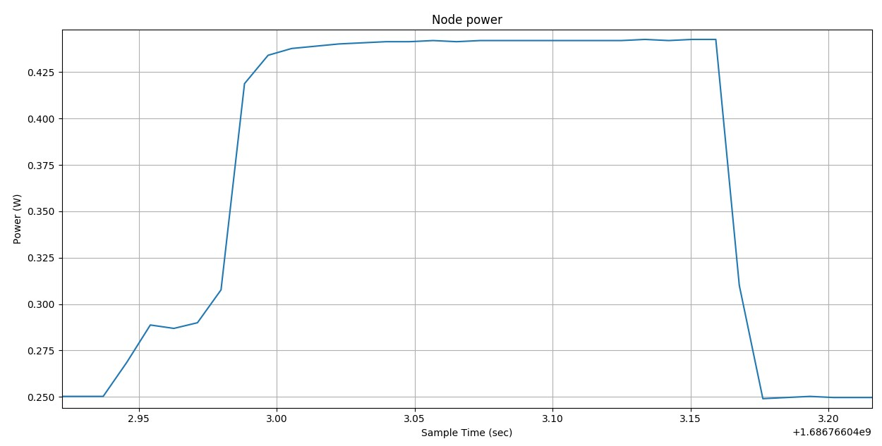
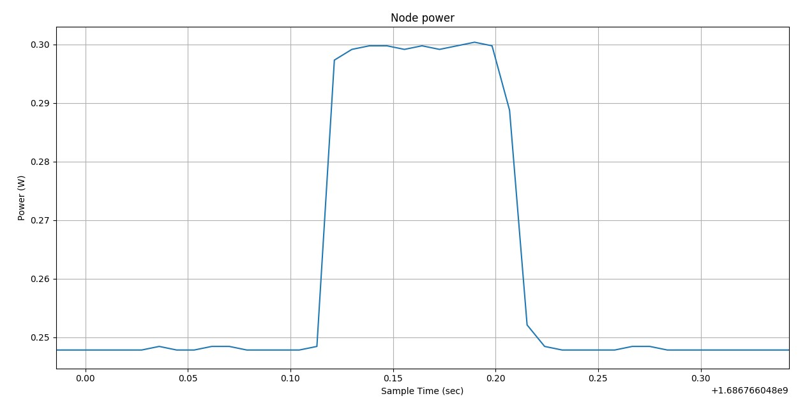
LORA ENERGY CONSUMPTION GRAPH
That represent the consumption to sent the message (widened)
To calculate the consumption
we just calculate the area of the polygons:
1- (BxH)+(BxH) = (0.2x0.19)+(0.04x0.033)=0.03932 W
2- BxH = 0.1x0.055 = 0.0055 W
That represent the consumption to receive the reply message (wided)

Slide 24
DEVICE CONSUMPTION
Device | Voltage | Wattage | Current | Time ON per hour (inside geofence) | Time ON per hour (outside geofence) | Required capacity per hour (inside geofence) | Required capacity per hour (outside geofence)
Board | 5V | 250mW | 50mA | 3600s | 3600s | 50mAh | 50mAh
LoRaWan (send) | 5V | 190mW | 38mA | 0.2s | 6x 0.2s | 0.0021 mAh | 0.012666mAh
LoraWan (receive) | 5V | 50mW | 10mA | 0.1s | 6x 0.1s | 0.000278mAh | 0.001666mAh
GPS | 5V | 175mW | 35mA | 10s to 100s | 6x(10 to 100s) | 0.98 mAh | 5.95mAh
Buzzer | 3.3V | 46.2mW | 14mA | - | 3600s | 0mAh | 14mAh
LED | 3.3V | 49.5mW | 15mA | - | 3600s | 0mAh | 15mAh
Total per hour | - | - | - | - | - | 50.98mAh | 84.95mAh
Total per 24hrs | - | - | - | - | - | 1223.52 mAh | 2038.8 mAh

Slide 25
SOME CONSIDERATIONS
We consider also the possibility to choose between different sampling times in order to let the user choose the preferred option between low consumption and high sample rate. In the following table are reported the different total consumptions for 24 hours of activity.
SAMPLING TIME | 5 minutes | 10 minutes | 30 minutes | 1 hour
Inside Geofence | 1485.6 mAh | 1342.8 mAh | 1246.2 mAh | 1223.52 mAh
Outside Geofence | 2181.6 mAh | 2038.8 mAh | 1942.2 mAh | 1919.52 mAh
In this table it is possible to notice that the difference in consumption is so little that it allows to adjust the rate to a faster rate in both scenarios. It is anyway not convenient to reduce communication rate outside geofence in order to find the pet with high accuracy.

Slide 26
DEVICE CONSUMPTION (assumptions)
Device | Voltage | Wattage | Current | Time ON per hour (inside geofence) | Time ON per hour (outside geofence) | Required capacity per hour (inside geofence) | Required capacity per hour (outside geofence)
Board | 5V | 250mW | 50mA/1mA | 60s (deep sleep) | 3600s | 1 + 0.833mAh | 50mAh
LoRaWan (send) | 5V | 190mW | 38mA | 0.2s | 6x 0.2s | 0.0021 mAh | 0.012666mAh
LoraWan (receive) | 5V | 50mW | 10mA | 0.1s | 6x 0.1s | 0.000278mAh | 0.001666mAh
GPS | 5V | 175mW | 35mA | 10s to 100s | 6x(10 to 100s) | 0.98 mAh | 5.95mAh
Buzzer | 3.3V | 46.2mW | 14mA | - | 1028.57s (0.4s on) | 0mAh | 4mAh
LED | 3.3V | 49.5mW | 15mA | - | 1028.57s (0.4s on) | 0mAh | 4.29mAh
Total per hour | - | - | - | - | - | 2.81mAh | 64.24mAh
Total per 24hrs | - | - | - | - | - | 67.57mAh | 1541.76mAh

Slide 27
SOME CONSIDERATIONS (assumptions)
Under the new hypothesis we have redefined the consumption of the system. In the first row it is possible to notice the huge battery saving when deep sleep mode is introduced whenever the pet is located inside the geofence. In the second row are shown the new values of consumption with smaller power cycles of light and sound (0.4 sec ON / 1 sec OFF)
SAMPLING TIME | 5 minutes | 10 minutes | 30 minutes | 1 hour
Inside Geofence | 568.8 mAh | 284.45 mAh | 110.95 mAh | 67.57 mAh
Outside Geofence | 1684.56 mAh | 1541.76 mAh | 1445.16 mAh | 1422.48 mAh
The new values of consumption open a new scenario in which with a battery of 2400mAh and a sampling time of 1 hour, if the device stays always inside the geofence the battery can last up to 35.5 days.
Outside geofence can be also noticed a reduction in consumption of about 500mAh

Slide 28
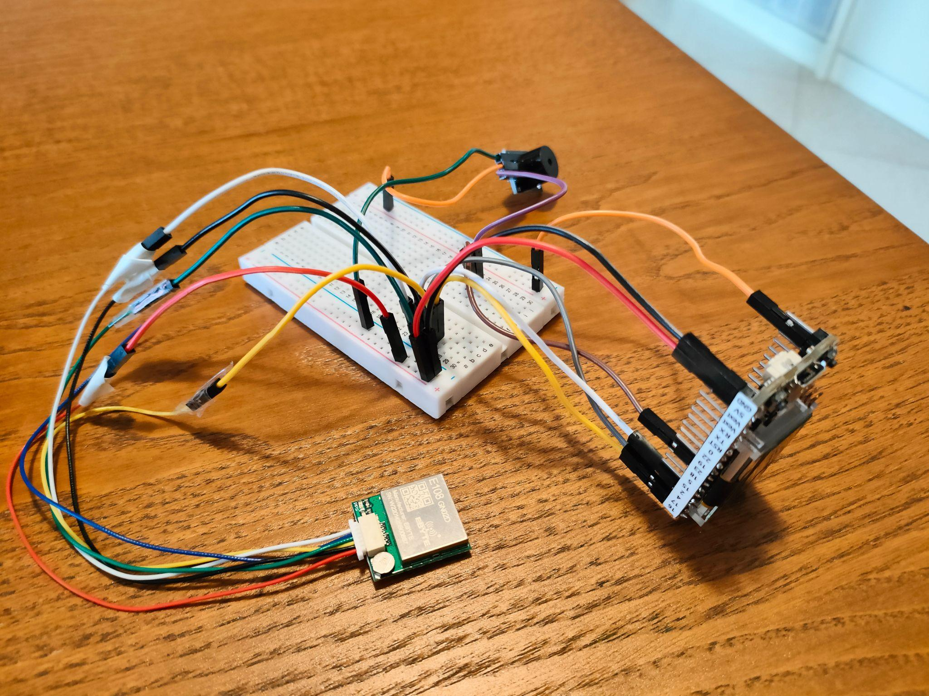
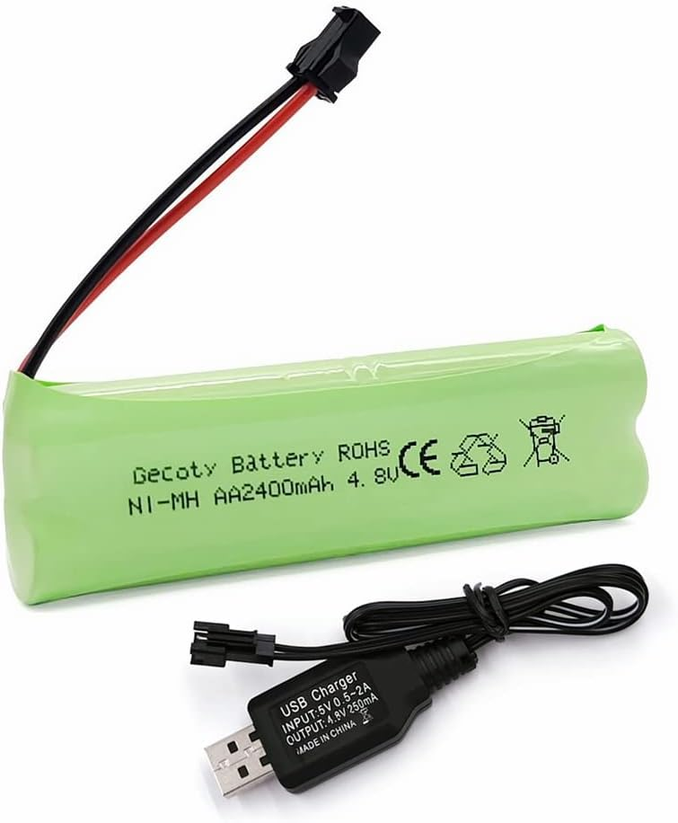
REAL WORLD
Here we can see the prototype, the connections are identical to the fritzing figure.
A digital multimeter has been used in order to check the real values of current of each sensor and actuator, discovering that the values are nearly close to the declared ones (check in the table above).
The GPS sensor whenever has found the coordinates switches to tracking mode, which consumes only 20mA instead of 35mA, but it is not in our interest because once the position is discovered the board puts every sensor in sleep mode until the following wake up. Moreover, in the table all the totals are based on the maximum time required to perform position discovery (100 seconds), but in real world scenario has been proved that in open field the expected time is always below 30 seconds.

Slide 29
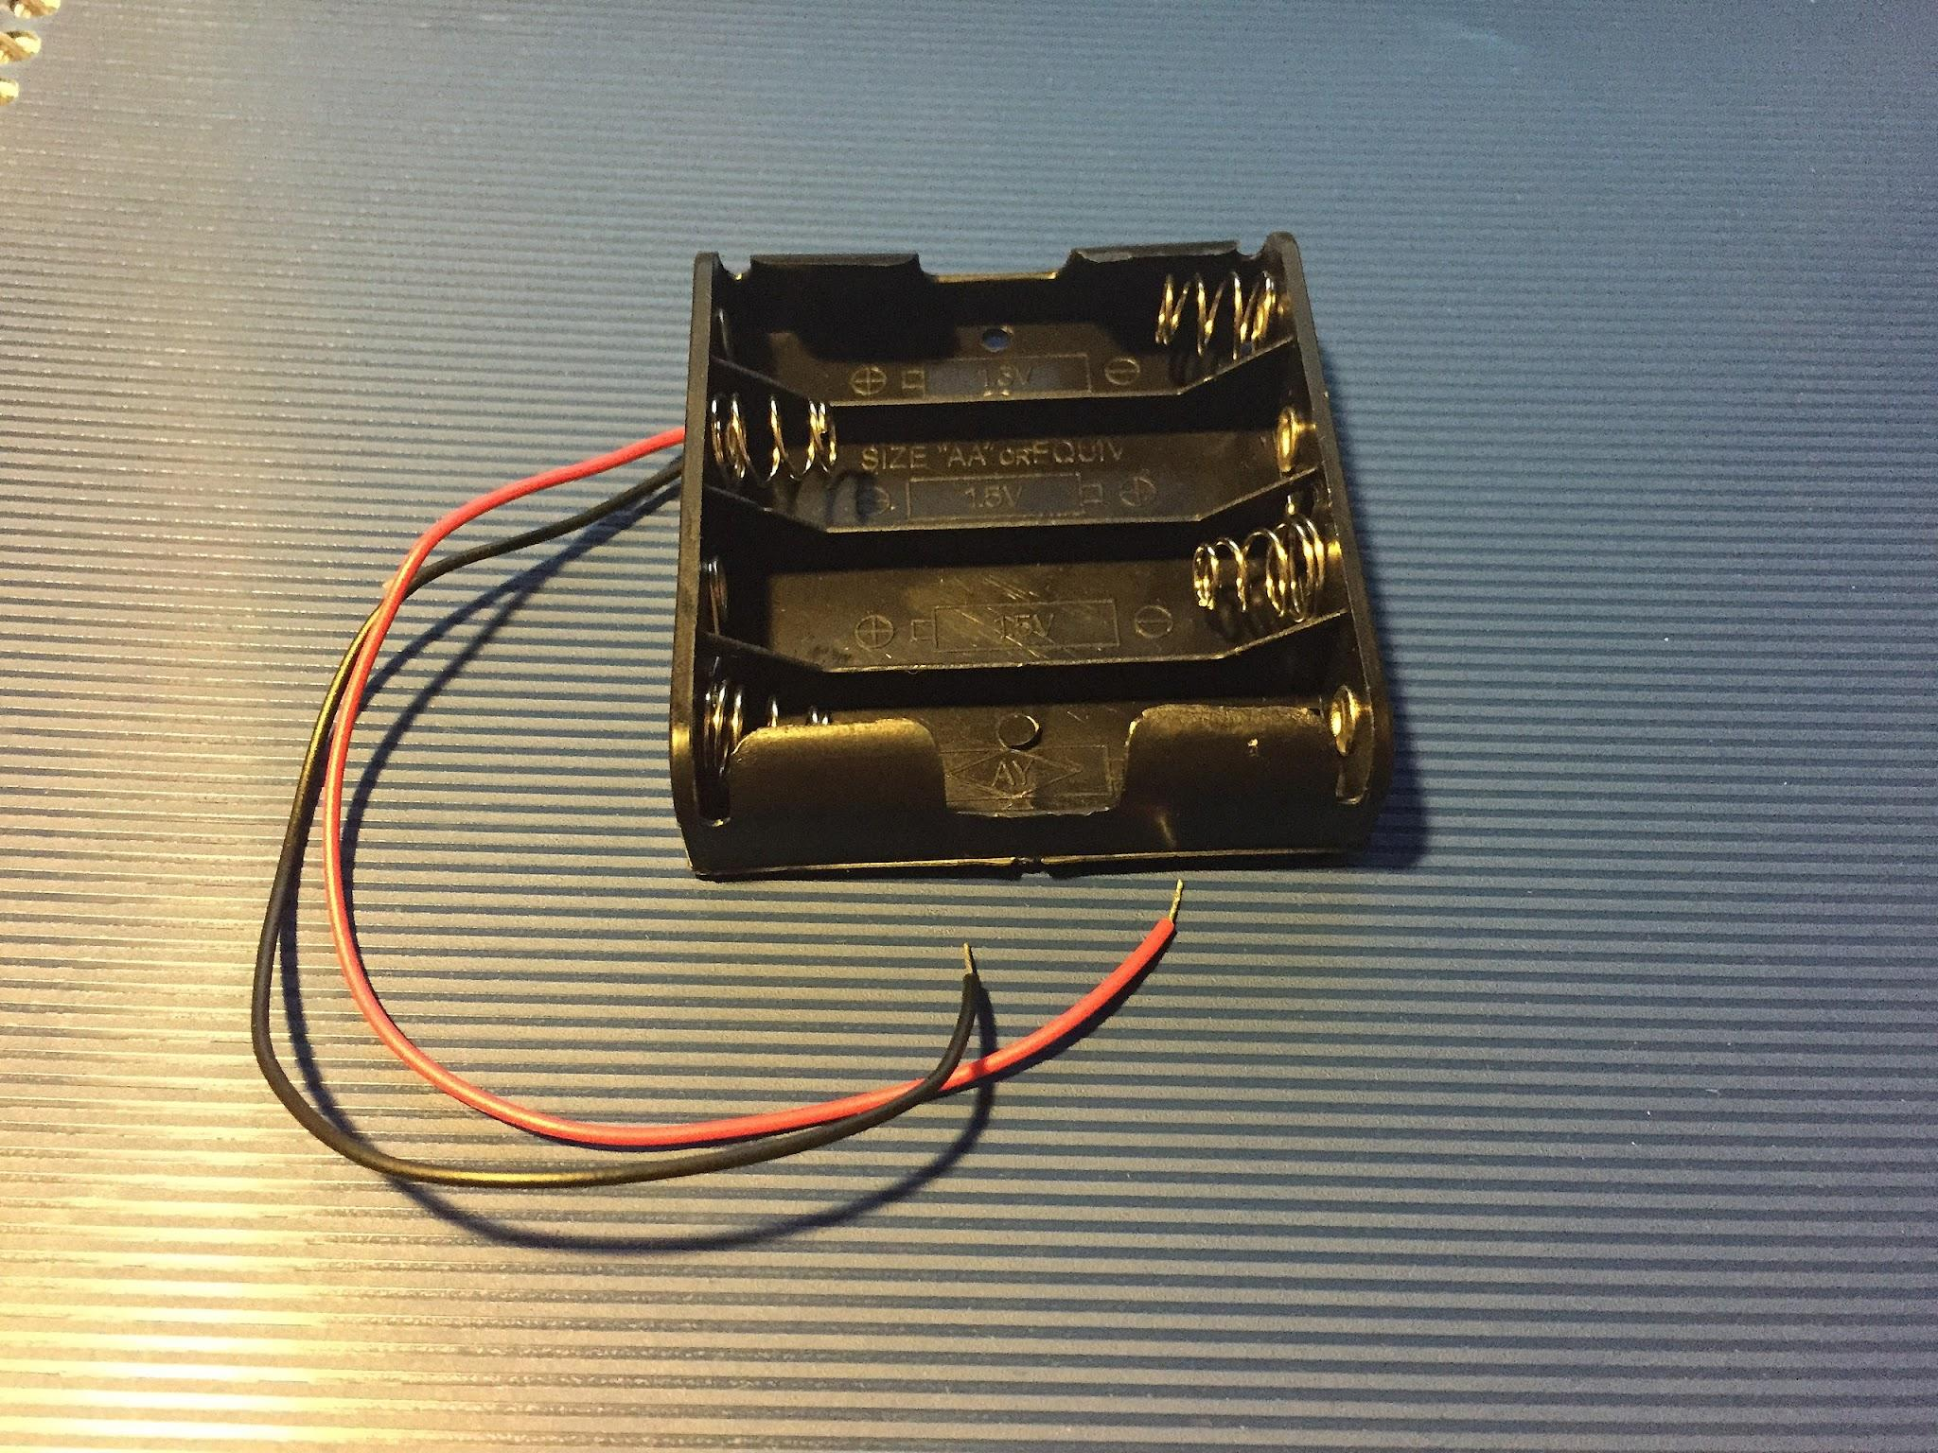
BATTERY CONSIDERATIONS
This kind of battery pack let us to reduce the weight on the pet and save space on the collar compared to a normal socket for 4 AA batteries. Moreover, the pack works at same voltage of the system and is rechargeable through its connector.
The disadvantage is the loss in terms of total capacity which is reduced from 5200 mAh to 2400 mAh. In terms of total working time this means that it can last, under first assumption, at most 2 days inside geofence with a sample rate of 1 hour and 1.14 day ca. outside geofence with a sample rate of 5 minutes, which satisfies the user requirement.
With our assumption, we can increase the autonomy of the prototype by making it during 35.5 days inside the geofence or 1.48 days outside the geofence.

Slide 30
FINAL CONSIDERATIONS
At the end, only the requested user requirements in terms of board autonomy in a specific use case wasn’t reached, since a significant portion of our time was dedicated to resolving code-related challenges arising from the UART configuration of the ESP32 LoRa Wi-Fi v2 on the RIOT OS platform, and we didn’t have the time to implement a deeper power consumption optimization.
Additionally, we encountered difficulties due to the absence of the GPS module library, requiring us to undertake the complex task of integrating the Arduino minmea library into the RIOT OS environment.
Unfortunately, despite our initial intention and pitch to include the accelerometer in the system, we encountered obstacles during the integration process similar to those faced with the minmea library, since the necessary library was unavailable on RIOT, and we were unable to successfully integrate it.

Slide 31
FUTURE WORK
Power consumption optimization: integration of board Deep Sleep or Hibernation
Integration of an accelerometer
Configurable sampling time
Integration with other devices

Slide 32



LINKS
GITHUB
PAAT: PET AS A THING
HACKSTER.IO

Slide 33
THANK YOU

